Slide 1
ATLAS Autoencoders Project
Submitted By:
Name: Aditi Rani
Google Classroom Name: aditirani 01

Slide 2
Contents
Aim
About Dataset
Pipeline
Storage Problems
Brief introduction of AutoEncoders
Graphs
Conclusion

Slide 3
Aim
This project aims to overcome the limitation of recording of information of proton-proton collisions.
Project uses AutoEncoders Neural Networks to compress the data and store the information required to reproduce the original input, in hidden layer.

Slide 4
Dataset
Dataset given has form of event ID; process ID; event weight; MET; METphi; obj1, E1, pt1, eta1, phi1; obj2, E2, pt2, eta2, phi2; . . .
The data used for training the network is obj, E, pt, eta, phi, where only jet particles, ‘j’ are considered.
Phi: Measurement of azimuthal angle.
Eta: Describes the angle of particle in relation to the particle beam.
Pt: Momentum perpendicular to the path of colliding particles.

Slide 5
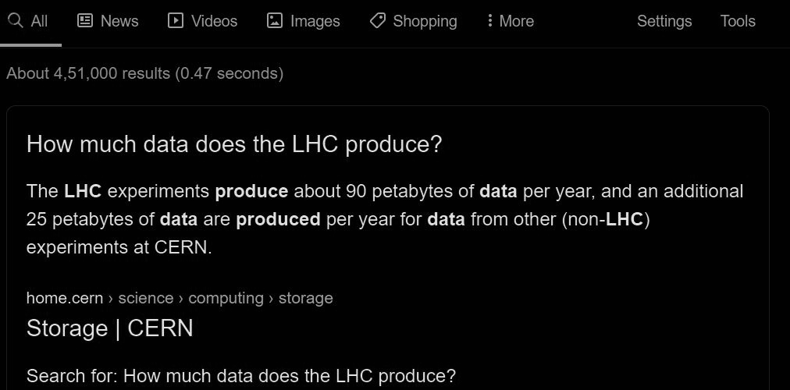
STORAGE PROBLEMS
90 Petabytes of data per year!!!

Slide 6
Autoencoders
Autoencoders are used to reduce the size of input by setting the target values equal to the inputs.
It extracts only required features of input data and generates a noise free and hence, memory reduced output.
This noise free output can be reverted back to the original input set.

Slide 7
Data Reading
Plotting Graphs
Setting Network
PIPELINE
Network Preparation
Output Plots
Network Training

Slide 8
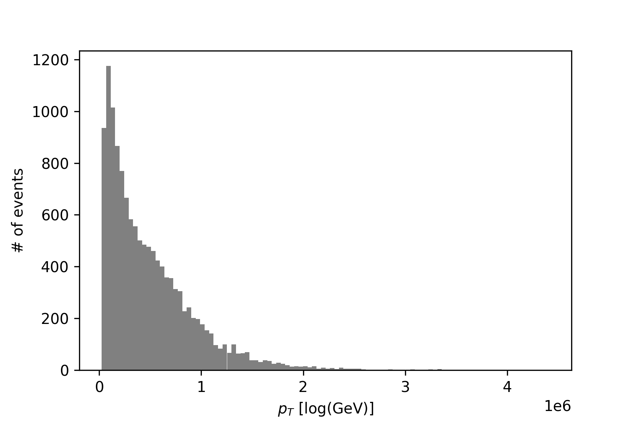
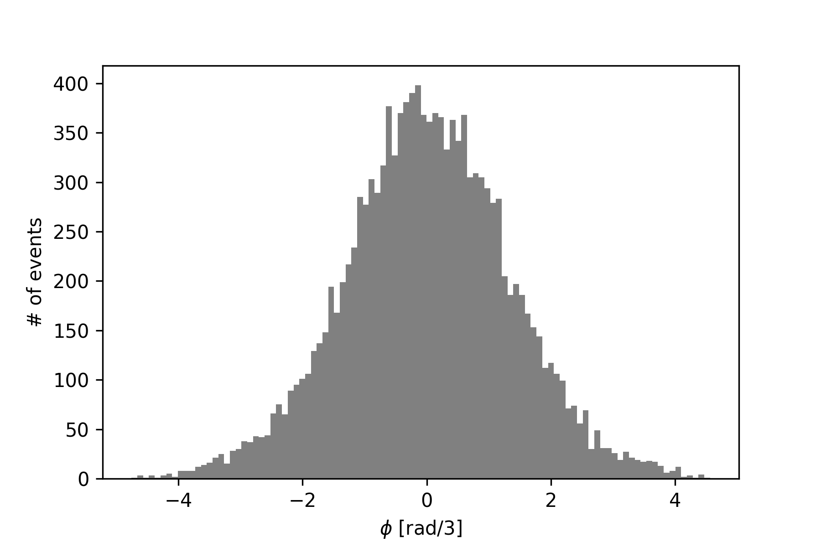
This graph shows the variation of E with number of events.
It tells that values between 0 and 0.5 have more probability.
Values greater than 2 have least probability to occur in events.
Note: These values are not actual values but they are taken in logarithm scale.
This graph shows the variation of eta with number of events.
It tells values around 0 are most occurring.
Values greater than 4 and lesser than -4 have least probability to occur in events.
One can neglect these low probability values as noise.

Slide 9
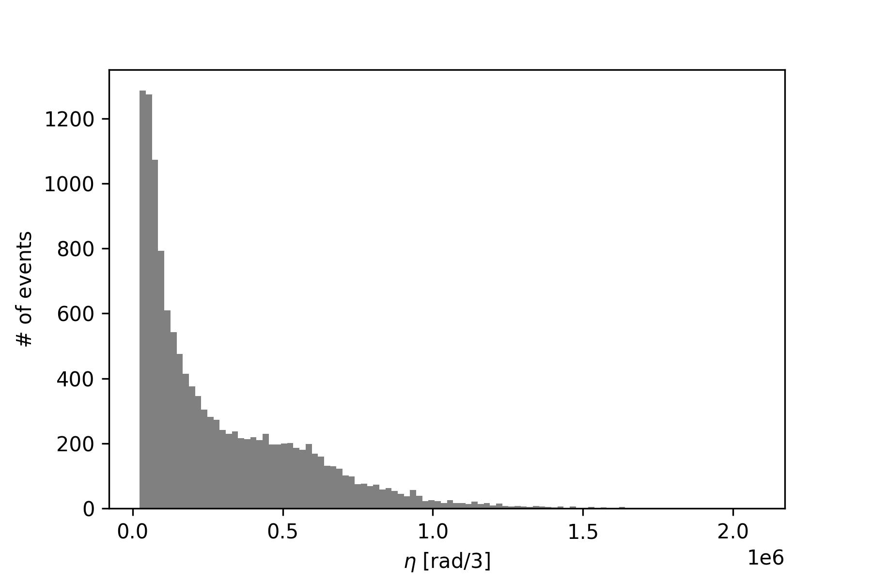
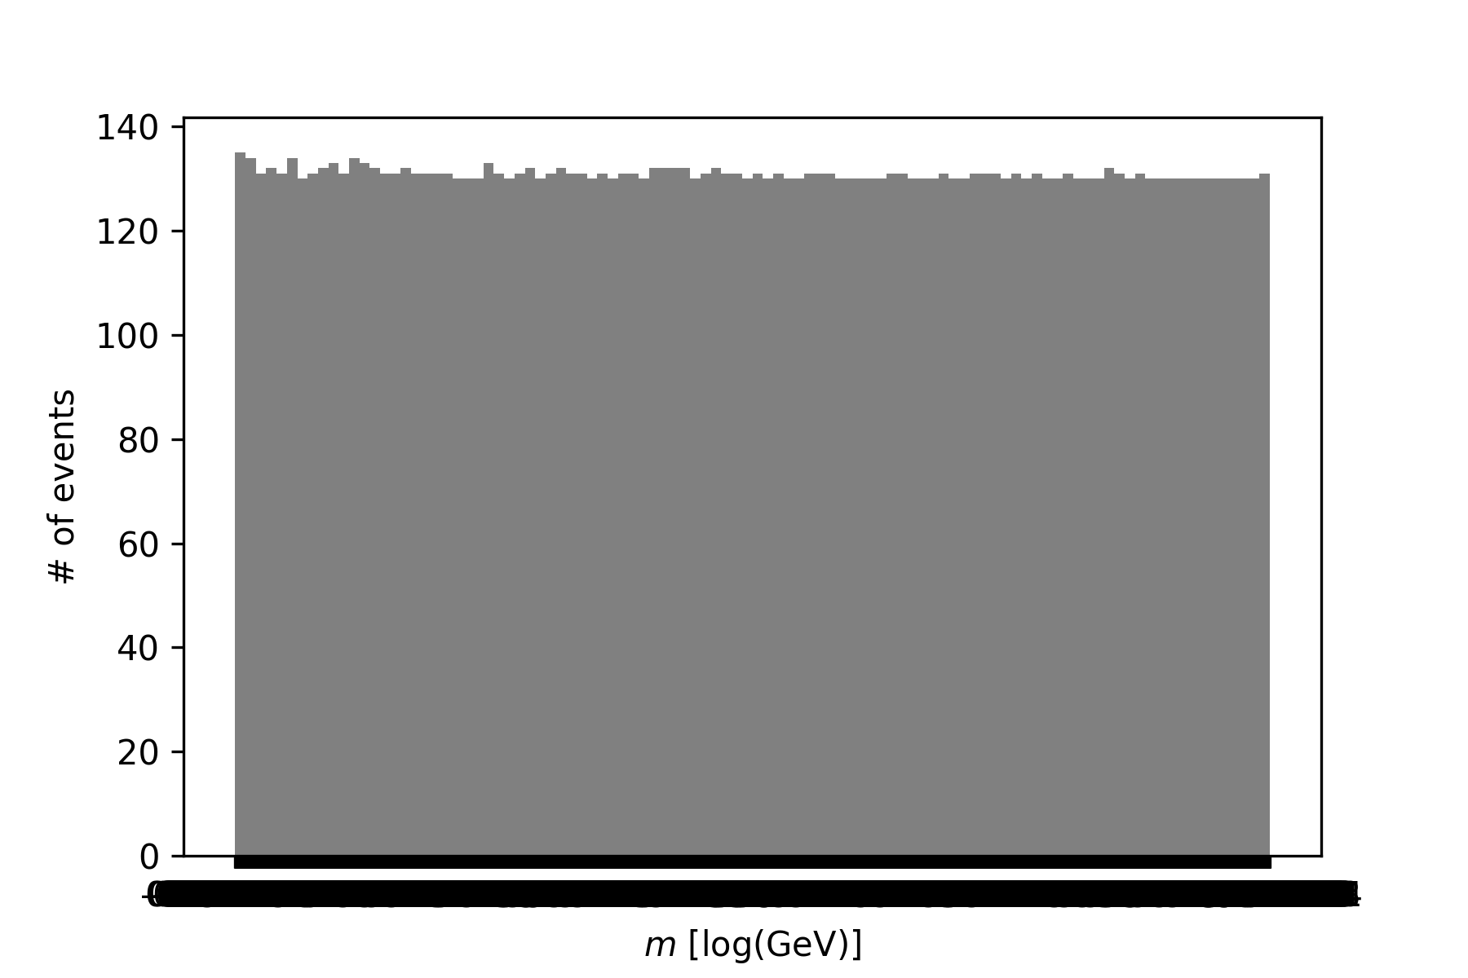
This graph shows the variation of pt with number of events.
It tells that values between 0 and 0.5 have more probability.
Values greater than 1.5 have least probability to occur in events.
This graph shows the variation of phi with number of events.
It tells that all values have equal probability to occur in events.

Slide 10
Conclusion
An input with reduced features and hence reduced memory is produced that can be reverted at any time to get the original input.

